Slide 1
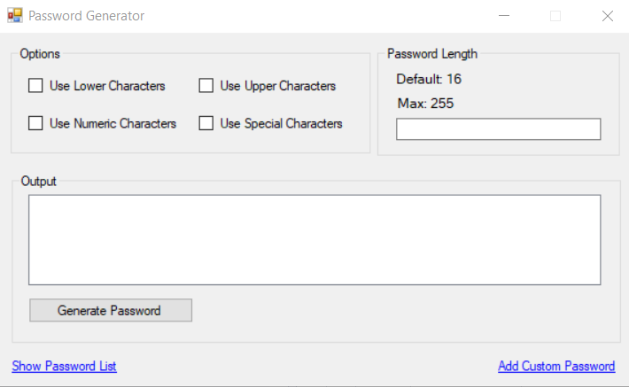
1. Easy to navigate UI
Password Generator
This password generator deskptop application creates passwords of various lengths and complexities and stores them securely within the application via a small local database.
All the functionality you need and all in one place.
Add or remove password variables with a click of the mouse
Generate multiple passwords and select the one that suits your needs best

Slide 2
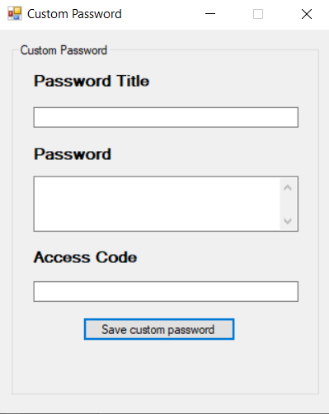
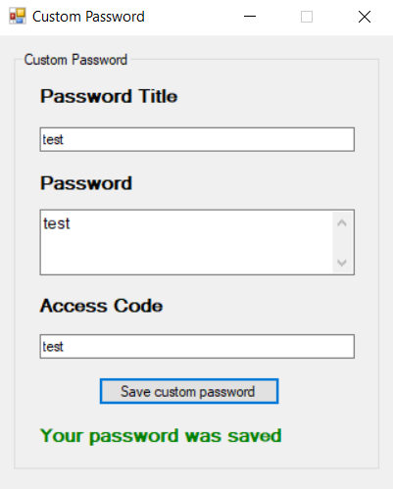
2. Protect your saved passwords with custom access codes
Creating a custom password and locking it with an access code can be done quickly and easily.
Select Anyone with the link can edit, then select Set password and enter a password.

Slide 3
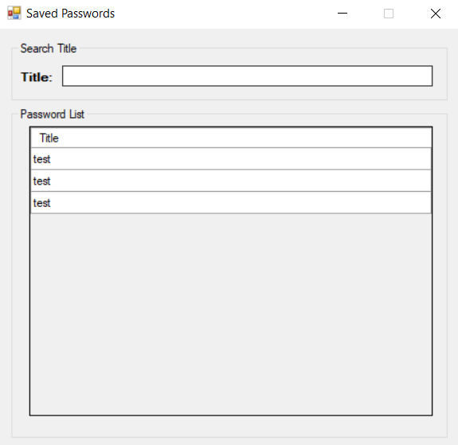
3. View saved passwords
Search or scroll through the list of saved passwords
Passords are securely saved within the application via a small SQL database so there is no risk of an internet data breach which is always possible if you cuurently use google or another web browser for password storage.

Slide 4
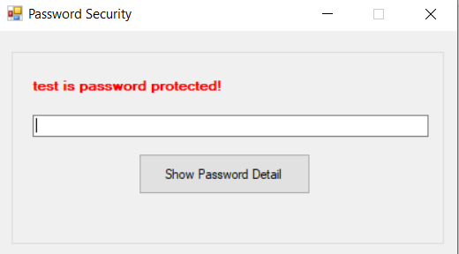
4. Remember your access codes
Accessing or editing a saved password requires your access code.

